Slide 1




Agile – Scrum in Software Engineering
A presentation by
Achyut Jagini (PES2UG19CS013)
Achyuta B Mudhol (PES2UG19CS014)
Akshay BK (PES2UG19CS030)
Anup Omkar (PES2UG19CS051)
Anurag.R.Simha (PES2UG19CS052)
The
10
team
th

Slide 2

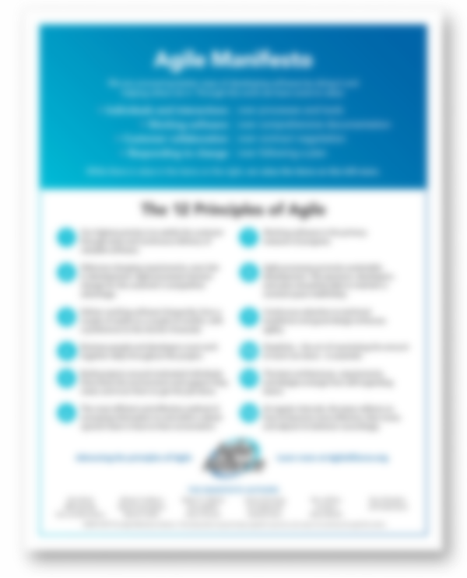
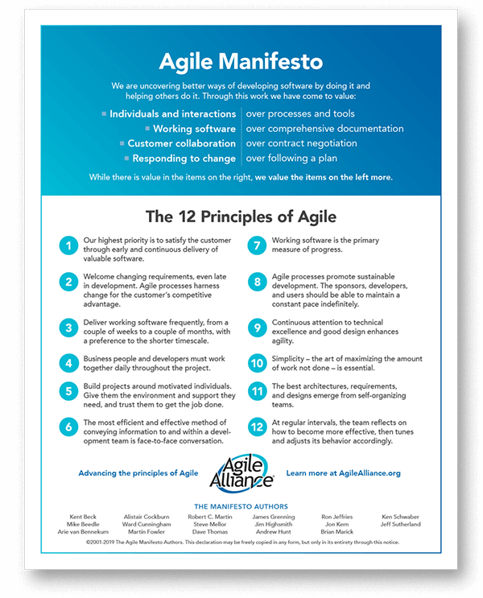
The Agile Manifesto

Slide 3
The Agile Manifesto

Slide 4
The Agile Manifesto

Slide 5
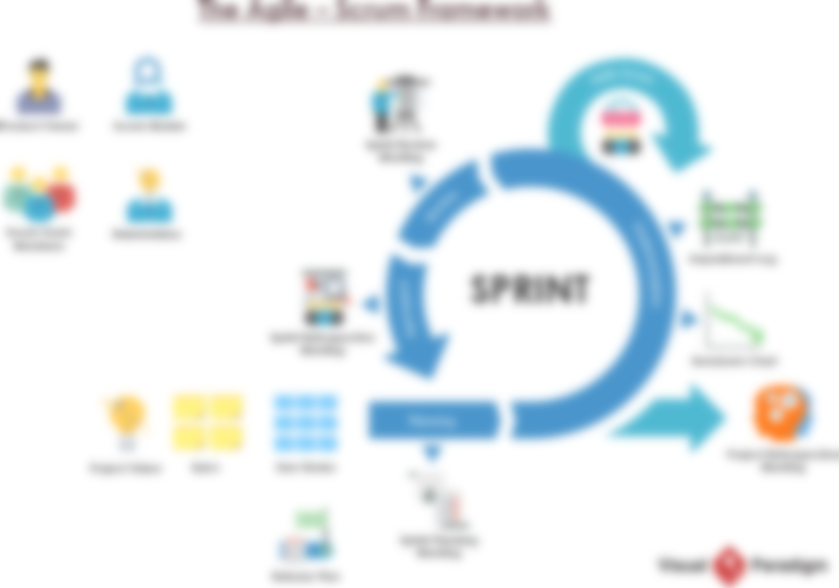

The Agile-Scrum Framework

Slide 6


The Software Companies
Service Inc.
Product Inc.

Slide 7


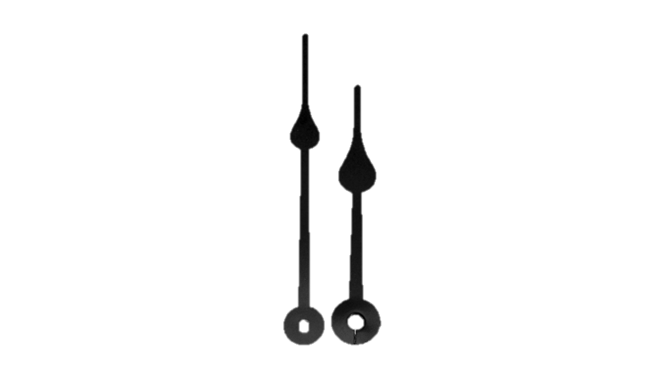
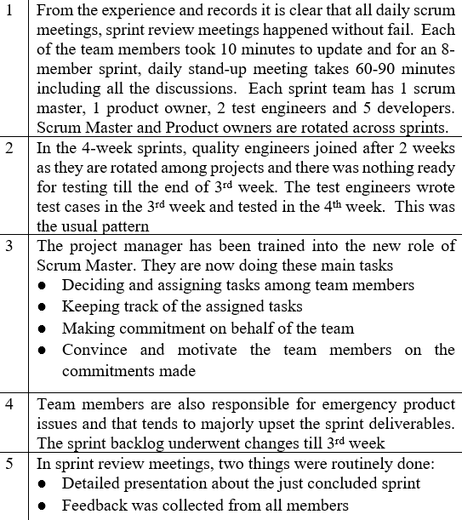
!!!??
Yes, it’s a ‘No Go’.
I’m afraid that it’s a ‘No Go’
My views are in this presentation...
Are you certain!?
The Software Companies
Wait, what!!??
So, what do you have to say about the partnership, Mr Stan?
Hold on...what!!??

Slide 8
Service Incorporated
Where did Service Inc. not meet the intent of the Agile Manifesto?
Service Inc operates on air-tight requirements and freezes it before committing their resources.
Focussed on building elaborate and exhaustive documentation.
Hierarchical and bureaucratic.
A few online discussions.
The Stakeholders were not involved in meetings.
Only the presentation was delivered and feedback was collected from all members but there were no measures taken to improve their productivity.
Product owners never met a customer.
Showered light upon the completion of work.
Didn’t deliver the product frequently to the customer.
The members were assigned roles by the Project manager.

Slide 9
Service Incorporated
Where did Service Inc. deviate from what is expected in a SCRUM implementation?
Long Scrum meetings – Meetings took 60-90 min. instead of short 10-15 min.
No Burndown charts prepared.
No impediment log is maintained.
Scrum master shown his authority instead of just guiding team to scrum principles.
Team members were not allowed to choose their roles and organize themselves.
Product owners and scrum masters are rotated across sprints.
There was no verification of increment against definition of done (DOD).
No proper sprint Review meetings.
No Scrum Retrospective meetings by any means.
Sprint Planning Meeting must be completed within hours, but took a week.
Product owners never met a customer.

Slide 10
The Result
What was the outcome of the key findings in the presentation by Mr Stan?
Sl. no | Key findings | Positive/negative contribution to go/no go recommendation
1 | From the experience and records it is clear that all daily scrum meetings, sprint review meetings happened without fail. Each of the team members took 10 minutes to update and for an 8- member sprint, daily stand-up meeting takes 60-90 minutes including all the discussions. Each sprint team has 1 scrum master, 1 product owner, 2 test engineers and 5 developers. Scrum Master and Product owners are rotated across sprints. | NO GO
2 | In the 4-week sprints, quality engineers joined after 2 weeks as they are rotated among projects and there was nothing ready for testing till the end of 3rd week. The test engineers wrote test cases in the 3rd week and tested in the 4th week. This was the usual pattern | NO GO
3 | The project manager has been trained into the new role of Scrum Master. They are now doing these main tasks ● Deciding and assigning tasks among team members ● Keeping track of the assigned tasks ● Making commitment on behalf of the team ● Convince and motivate the team members on the commitments made | NO GO
4 | Team members are also responsible for emergency product issues and that tends to majorly upset the sprint deliverables. The sprint backlog underwent changes till 3rd week | NO GO
5 | In sprint review meetings, two things were routinely done: ● Detailed presentation about the just concluded sprint ● Feedback was collected from all members | NO GO
6 | After the Sprint planning meeting, task list was only a draft. The product owner discussed the draft with the centre manager and based on his feedback, there were few online discussions with the scrum master and team members following which task list is finalized by end of 1st week of the sprint. | NO GO
7 | In terms of metric, the backlog at the beginning of the scrum is more ambitious than the average velocity of the scrum teams recorded so far as the teams prefer to take ambitious targets. They were encouraged to do so. | NO GO
8 | Product owners in the scrum teams have worked with the products ever since the centres have been set up but have never met a customer | NO GO

Slide 11

The Revenue Growth of Service Incorporated
How can Service Inc achieve 40% growth in margin while achieving only a 25% growth in revenue?
The Formula:
Margin = $\frac{Revenue Generated− Expenditure to the company}{Revenue Generated}$
Margin refers to the amount by which revenue from sales exceeds costs in a business.
Revenue is the income generated to the company by selling its products or services to the customers.
A company can achieve high growth in Margin while having lesser growth in Revenue by reducing its expenditure which can be clearly seen from the above formula. This is termed as “High-Low Profit Margin”.
Microsoft is one Such example.
Also the Service Inc were providing services to discontinued products, or near end of life or planned to be discontinued EOL products, which requires less human resource hence less expenditure to the company, which in other words more growth in profit. Since they were discontinued products, there would be less number of users for that product hence the revenue growth would be less.
Product Inc had been one key client of Service Inc. It had a large investment in Service Inc, and it visualized higher benefits in Service Inc coming up the value chain. With this in mind, the SVP came up with a year wise growth plan that involves making Product Inc agree on handing over execution of a part of their product line roadmap for growing products on a revenue sharing basis.

Slide 12
Service Incorporated VS Product Incorporated
What are a couple of observable cultural differences between the two companies?
Product Inc is a flat organization with open offices, where engineers and managers including VPs and SVPs share open cubicles, with the senior managers having offices in corners where engineers do not need to go often, and are designed with dedicated conference rooms for meetings. On the contrary, in Service Inc the organization was hierarchical and bureaucratic and, one can make out the seniority of a manager in the organization by the size of his desk and room that he has been allocated. No Burndown charts prepared.
Product Inc Works as a self-organizing team with iterative and incremental development, delivering progress after every two weeks, take valuable feedbacks from stakeholders, whereas Service Inc Operates on building tight requirements, tends to freeze it before committing their resources, have trained project managers on coordination, have skilled program manager on rigorous change management, builds an existing documentation. Scrum master shown his authority instead of just guiding team to scrum principles.
In Product Inc. Scrum master doesn’t assign task but rather focuses on developing a high performance team for better product development, whereas in Service Inc. Project Manager who were trained to be scrum masters assigns tasks to scrum team, acts as manager and commits on the team’s behalf.
Product Incs’ culture of having open conversations without having to make every single talk between employees a scheduled meeting. When Stan visits Service Inc., he talks directly to engineers and junior managers rather than seeking meetings with them in the presence of Service Inc. general managers. This was not very popular with Service Inc as they took pride in having a hierarchy in the office.
Product Inc. was greatly concerned with it’s customers whereas Service Inc. gave more importance to contract over customer collaboration.
Product Inc. always relied on certainty, on contrary constant change and uncertainty were the only truth in Service Inc.
Product Inc were aware of scum practices and was agile, on contrary, even though Service Inc claimed that they were practicing Scrum and Agile methodology is inefficient and practiced traditional approach in the name of Scrum.

Slide 13
The End

